Slide 1
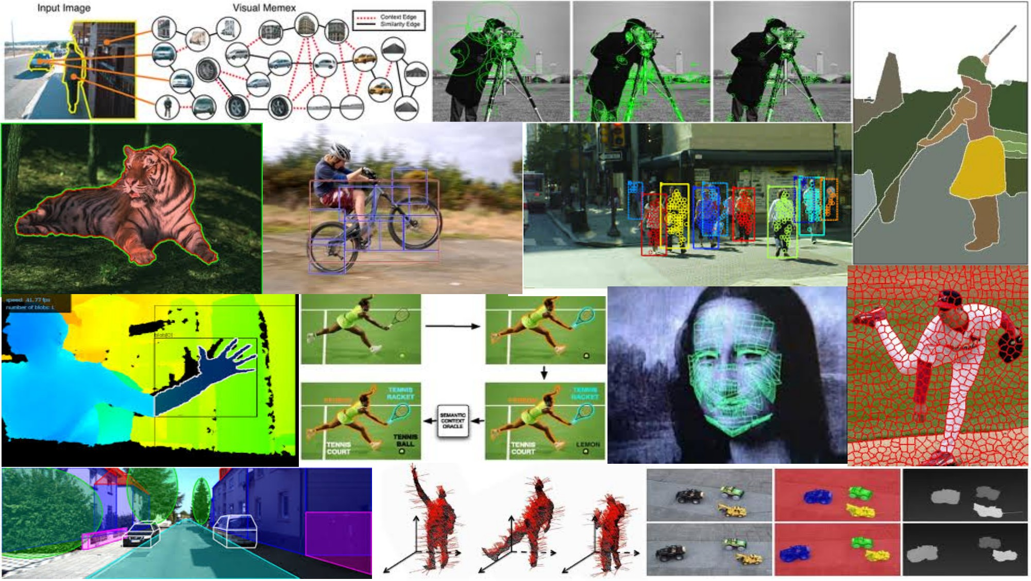
Deep neural networks I May 29th, 2018
Yong Jae Lee
UC Davis
Many slides from Rob Fergus, Svetlana Lazebnik, Jia-Bin Huang, Derek Hoiem

Slide 2
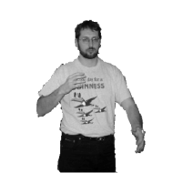


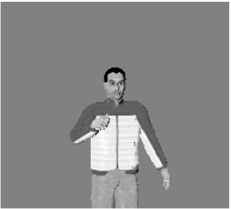




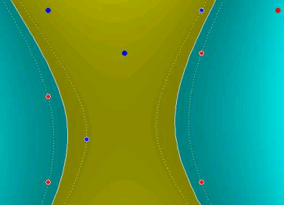
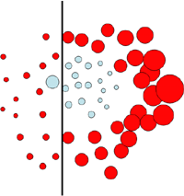
Discriminative classifiers
Nearest neighbor
Neural networks
10⁶ examples
Shakhnarovich, Viola, Darrell 2003
Berg, Berg, Malik 2005...
LeCun, Bottou, Bengio, Haffner 1998
Rowley, Baluja, Kanade 1998
…
Support Vector Machines
Boosting
Conditional Random Fields
Guyon, Vapnik
Heisele, Serre, Poggio, 2001,…
Viola, Jones 2001, Torralba et al. 2004, Opelt et al. 2006,…
McCallum, Freitag, Pereira 2000; Kumar, Hebert 2003
…
Slide adapted from Antonio Torralba

Slide 3
Discriminative classifiers
Nearest neighbor
Neural networks
10⁶ examples
Shakhnarovich, Viola, Darrell 2003
Berg, Berg, Malik 2005...
LeCun, Bottou, Bengio, Haffner 1998
Rowley, Baluja, Kanade 1998
…
Support Vector Machines
Boosting
Conditional Random Fields
Guyon, Vapnik
Heisele, Serre, Poggio, 2001,…
Viola, Jones 2001, Torralba et al. 2004, Opelt et al. 2006,…
McCallum, Freitag, Pereira 2000; Kumar, Hebert 2003
…
Slide adapted from Antonio Torralba

Slide 4
Outline
Deep Neural Networks
Convolutional Neural Networks (CNNs)

Slide 5


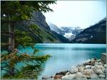

Traditional Image Categorization: Training phase
Training Images
Training
Training Labels
Image Features
Classifier Training
Trained Classifier

Slide 6
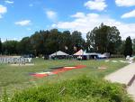
Traditional Image Categorization: Testing phase
Training Images
Training
Training Labels
Image Features
Classifier Training
Trained Classifier
Testing
Image Features
Trained Classifier
Prediction
Outdoor
Test Image

Slide 7
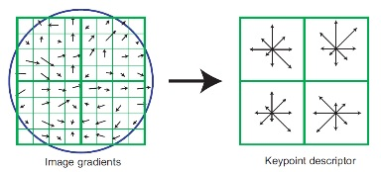
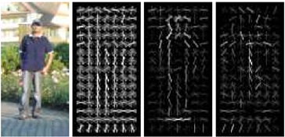
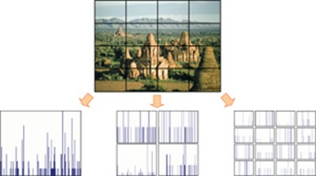
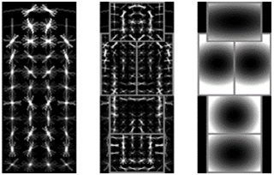
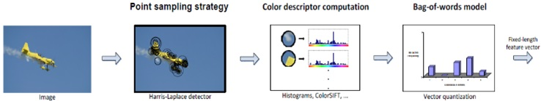
Features have been key..
SIFT [Loewe IJCV 04]
HOG [Dalal and Triggs CVPR 05]
Hand-crafted
SPM [Lazebnik et al. CVPR 06]
DPM [Felzenszwalb et al. PAMI 10]
Color Descriptor [Van De Sande et al. PAMI 10]

Slide 8
What about learning the features?
Learn a feature hierarchy all the way from pixels to classifier
Each layer extracts features from the output of previous layer
Layers have (nearly) the same structure
Train all layers jointly (“end-to-end”)
Image/ Video
Pixels
Layer 1
Layer 2
Layer 3
Simple Classifier

Slide 9
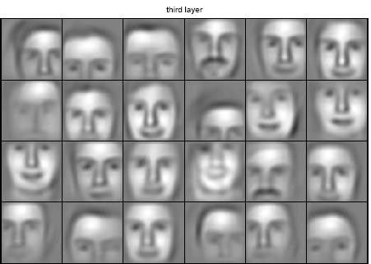
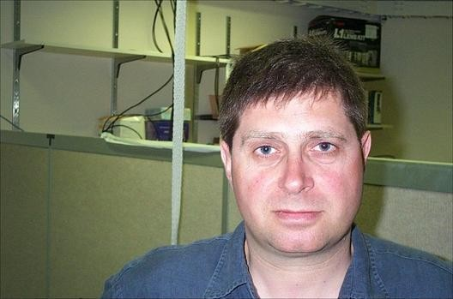
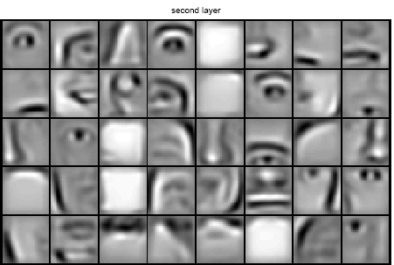
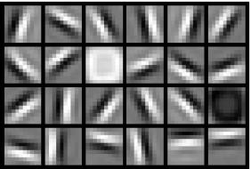
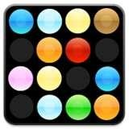
Learning Feature Hierarchy
Goal: Learn useful higher-level features from images
Feature representation
3rd layer “Objects”
Input data
2nd layer “Object parts”
1st layer “Edges”
Lee et al., ICML 2009; CACM 2011
Pixels
Slide: Rob Fergus

Slide 10
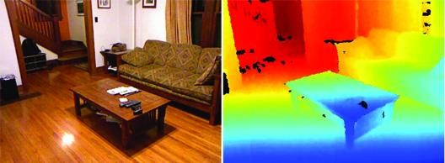
Learning Feature Hierarchy
Better performance
Other domains (unclear how to hand engineer):
Kinect
Video
Multi spectral
Feature computation time
Dozens of features now regularly used
Getting prohibitive for large datasets (10’s sec /image)
Slide: R. Fergus

Slide 11
“Shallow” vs. “deep” architectures
Traditional recognition: “Shallow” architecture
Image/ Video
Pixels
Hand-designed feature extraction
Trainable classifier
Object Class
Deep learning: “Deep” architecture
Image/ Video
Pixels
Layer 1
Layer N
Simple classifier
…
Object Class

Slide 12
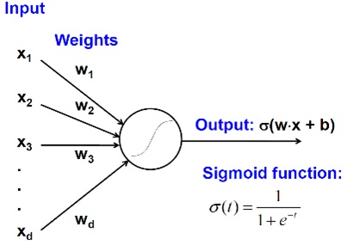
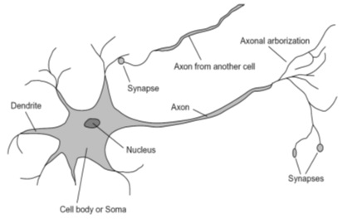
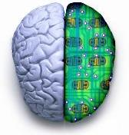
Biological neuron and Perceptrons
A biological neuron
An artificial neuron (Perceptron)
- a linear classifier
Notes:
signals are sent from the axon of one neuron to a dendrite of another... If the voltage changes by a large enough amount, an all-or-none electrochemical pulse called an action potential is generated, which activates synaptic connections with other cells

Slide 13
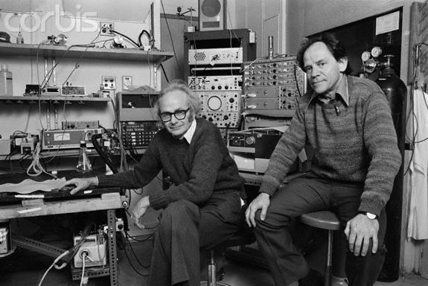
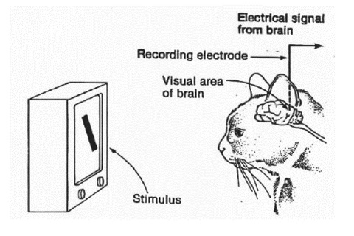
Simple, Complex, and Hyper-complex cells
video
David H. Hubel and Torsten Wiesel
Suggested a hierarchy of feature detectors in the visual cortex, with higher level features responding to patterns of activation in lower level cells, and propagating activation upwards to still higher level cells.
David Hubel's Eye, Brain, and Vision
Notes:
D. Hubel and T. Wiesel (1959, 1962, Nobel Prize 1981)
Visual cortex consists of a hierarchy of simple, complex, and hyper-complex cells
In one experiment, done in 1959, they inserted a microelectrode into the primary visual cortex of an anesthetized cat. They then projected patterns of light and dark on a screen in front of the cat.

Slide 14
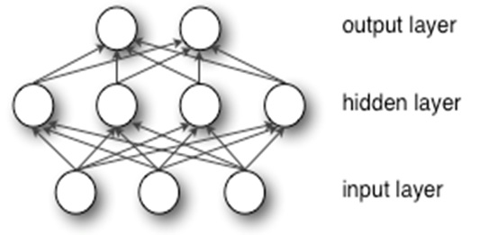
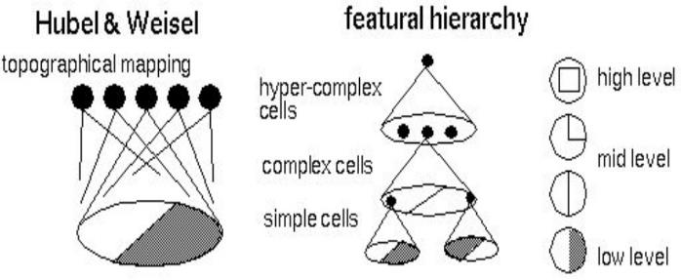
Hubel/Wiesel Architecture and Multi-layer Neural Network
Hubel and Weisel’s architecture
Multi-layer Neural Network
- A non-linear classifier
Notes:
simple cells: neurons that fire rapidly when presented with lines at one angle (orientation-sensitive). Respond to light patterns and dark patterns differently. Found all over the visual cortex.
complex cells: respond to their edges in a larger region of the visual field. This suggested that complex cells received input from lower level simple cells by way of a receptive field.
"hypercomplex" cells: respond to more complex combinations of the simple features, for example to two edges at right angles to each other in a yet larger region of the visual field.
These studies showed how the visual system constructs complex representations of visual information from simple stimulus features.

Slide 15
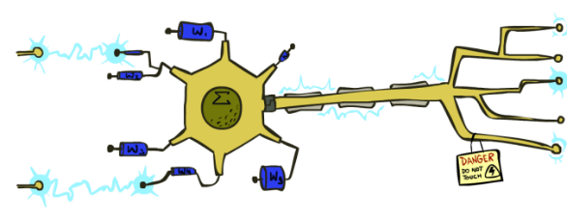
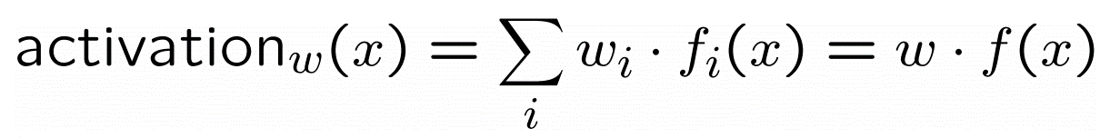
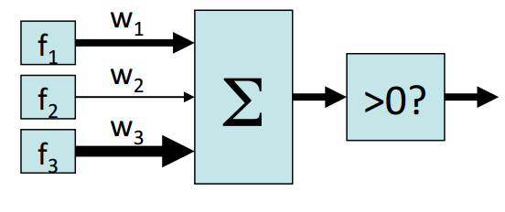
Neuron: Linear Perceptron
Inputs are feature values
Each feature has a weight
Sum is the activation
If the activation is:
Positive, output +1
Negative, output -1
Slide credit: Pieter Abeel and Dan Klein

Slide 16
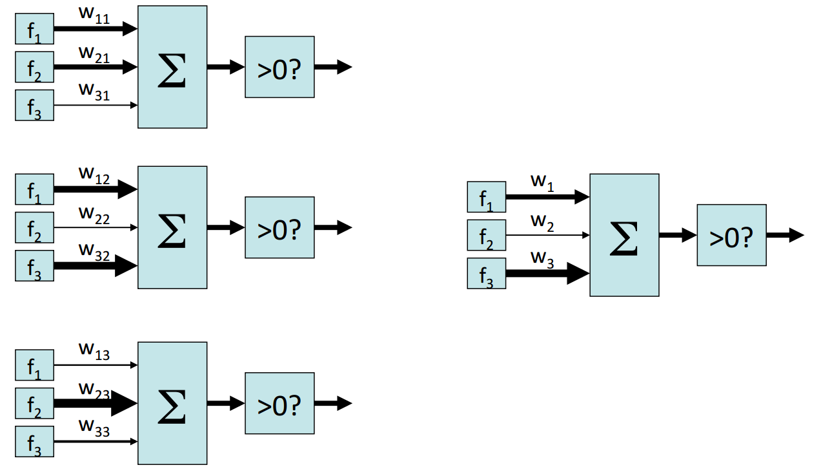
Two-layer perceptron network
Slide credit: Pieter Abeel and Dan Klein

Slide 17
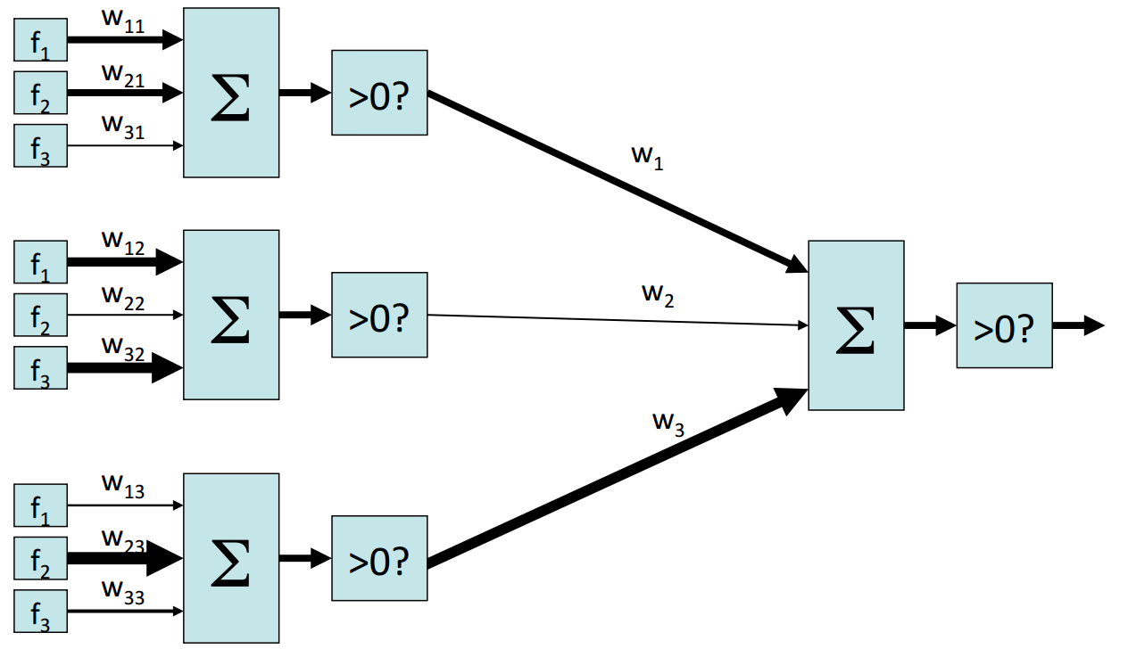
Two-layer perceptron network
Slide credit: Pieter Abeel and Dan Klein

Slide 18
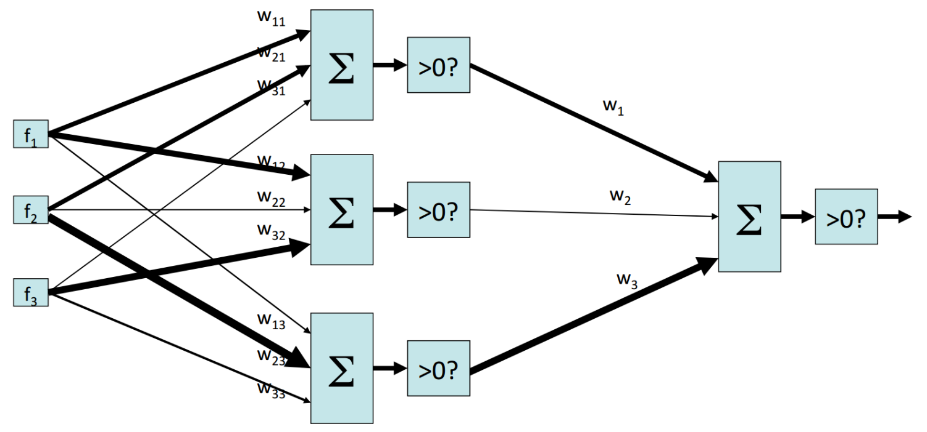
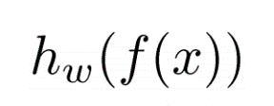
Two-layer perceptron network
Slide credit: Pieter Abeel and Dan Klein

Slide 19
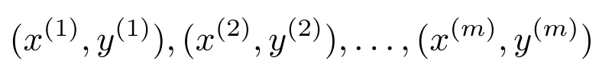
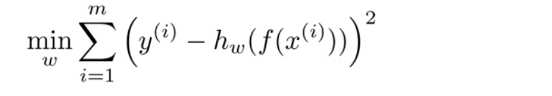
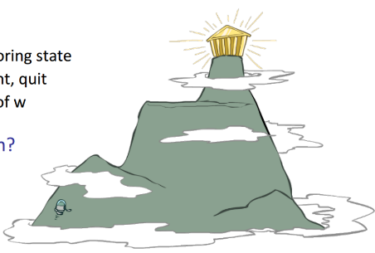
Learning w
Training examples
Objective: a misclassification loss
Procedure:
Gradient descent / hill climbing
Slide credit: Pieter Abeel and Dan Klein

Slide 20
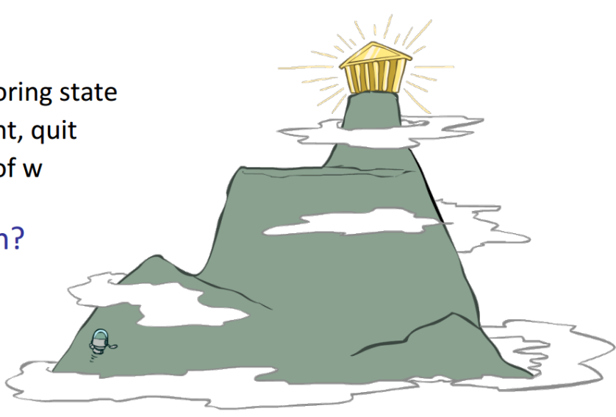
Hill climbing
Simple, general idea:
Start wherever
Repeat: move to the best neighboring state
If no neighbors better than current, quit
Neighbors = small perturbations of w
What’s bad?
Optimal?
Slide credit: Pieter Abeel and Dan Klein
Notes:
Can get stuck in bad local optima

Slide 21
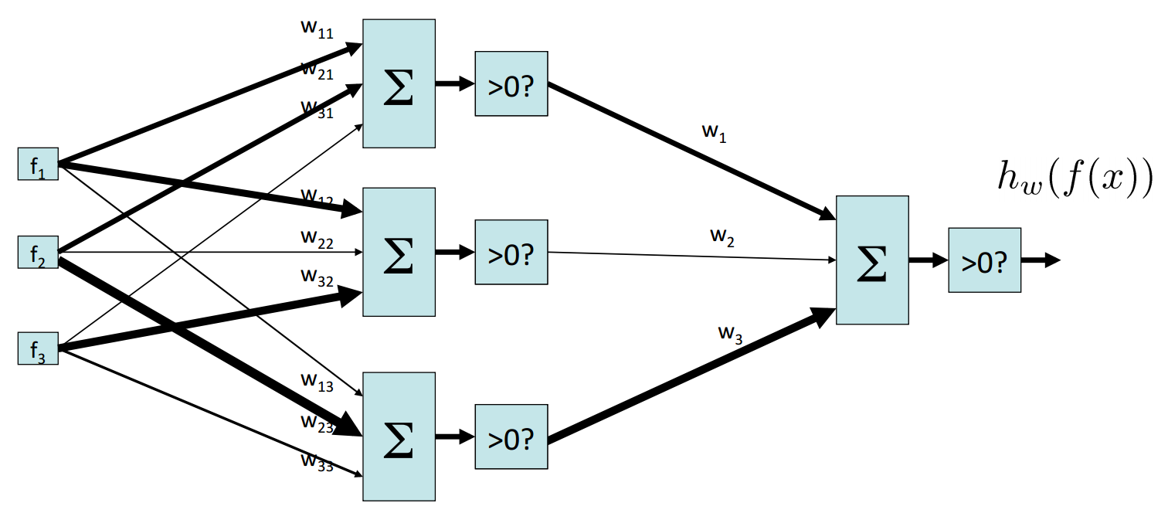
Two-layer perceptron network
Slide credit: Pieter Abeel and Dan Klein

Slide 22
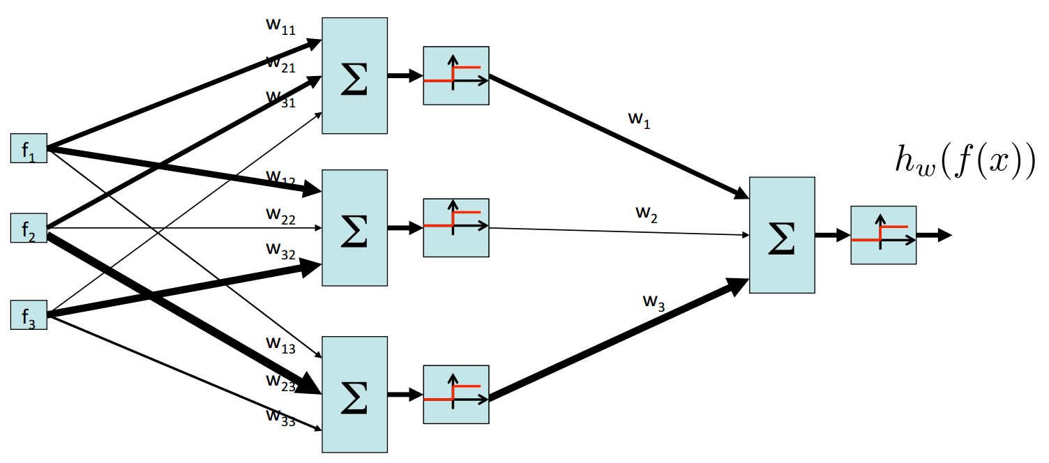
Two-layer perceptron network
Slide credit: Pieter Abeel and Dan Klein

Slide 23
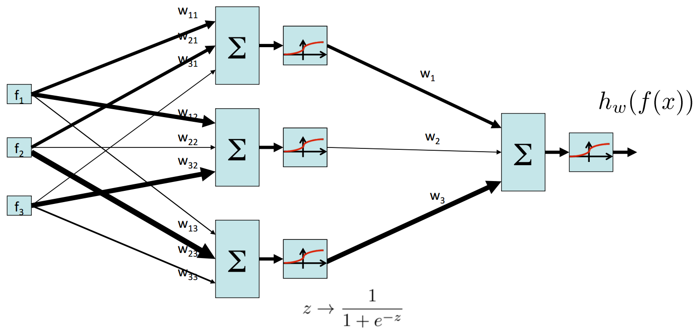
Two-layer neural network
Slide credit: Pieter Abeel and Dan Klein

Slide 24
Neural network properties
Theorem (Universal function approximators): A two-layer network with a sufficient number of neurons can approximate any continuous function to any desired accuracy
Practical considerations:
Can be seen as learning the features
Large number of neurons
Danger for overfitting
Hill-climbing procedure can get stuck in bad local optima
Approximation by Superpositions of Sigmoidal Function,1989
Slide credit: Pieter Abeel and Dan Klein

Slide 25
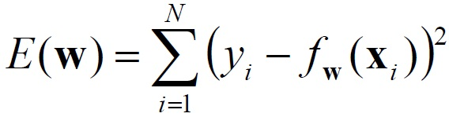
Multi-layer Neural Network
A non-linear classifier
Training: find network weights w to minimize the error between true training labels and estimated labels
Minimization can be done by gradient descent provided f is differentiable
This training method is called back-propagation

Slide 26
Outline
Deep Neural Networks
Convolutional Neural Networks (CNNs)

Slide 27
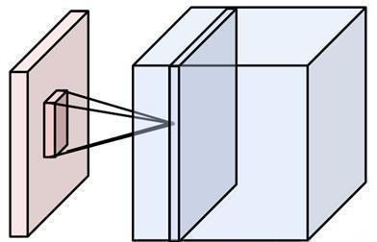
Convolutional Neural Networks (CNN, ConvNet, DCN)
CNN = a multi-layer neural network with
Local connectivity:
Neurons in a layer are only connected to a small region of the layer before it
Share weight parameters across spatial positions:
Learning shift-invariant filter kernels
Image credit: A. Karpathy

Slide 28
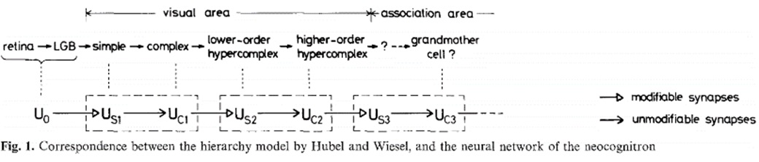
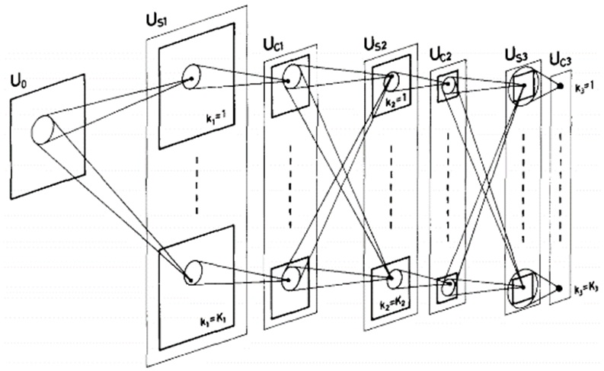
Neocognitron [Fukushima, Biological Cybernetics 1980]
Deformation-Resistant Recognition
S-cells: (simple)
- extract local features
C-cells: (complex)
- allow for positional errors
Notes:
hierarchical, multilayered neural network inspired by the model proposed by Hubel & Wiesel in 1959
The neocognitron is a natural extension of these cascading models. The neocognitron consists of multiple types of cells, the most important of which are called S-cells and C-cells.[2] The local features are extracted by S-cells, and these features' deformation, such as local shifts, are tolerated by C-cells. Local features in the input are integrated gradually and classified in the higher layers.[3] The idea of local feature integration is in several other models, such as LeNet and SIFT model.

Slide 29
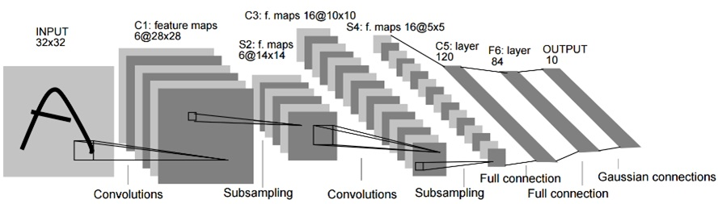
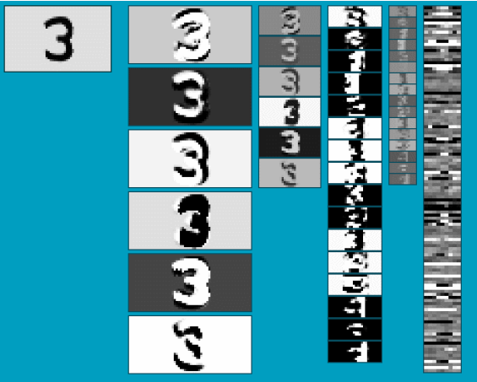
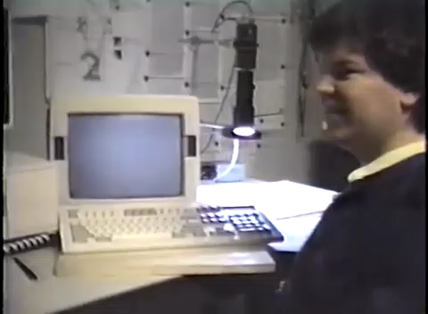
LeNet [LeCun et al. 1998]
Stack multiple stages of feature extractors
Higher stages compute more global, more invariant features
Classification layer at the end
Gradient-based learning applied to document recognition [LeCun, Bottou, Bengio, Haffner 1998]
LeNet-1 from 1993

Slide 30
Convolutional Neural Networks
Feature maps
Spatial pooling
Non-linearity
Convolution (Learned)
Input Image

Slide 31
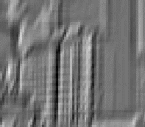


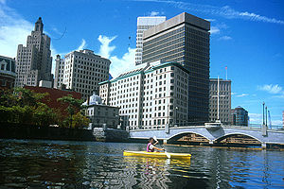
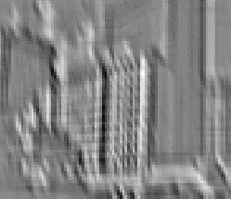
What is a Convolution?
Weighted moving sum
...
Input
Feature Activation Map

Slide 32
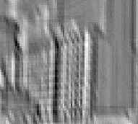


Why Convolution?
Few parameters (filter weights)
Dependencies are local
Translation invariance
...
Input
Feature Map
Notes:
connect each neuron to only a local region of the input volume.

Slide 33



Convolutional Neural Networks
Feature maps
Spatial pooling
Non-linearity
Convolution (Learned)
...
Input Image
Input
Feature Map

Slide 34

Convolutional Neural Networks
Feature maps
Rectified Linear Unit (ReLU)
Spatial pooling
Non-linearity
Convolution (Learned)
Input Image
slide credit: S. Lazebnik

Slide 35



Non-Linearity
Per-element (independent)
Options:
Tanh
Sigmoid: 1/(1+exp(-x))
Rectified linear unit (ReLU)
Makes learning faster
Simplifies backpropagation
Avoids saturation issues → Preferred option

Slide 36




Convolutional Neural Networks
Feature maps
Normalization
Max pooling
Spatial pooling
Non-linearity
Convolution (Learned)
Max-pooling: a non-linear down-sampling Provide translation invariance
Input Image

Slide 37

Spatial Pooling
Average or max
Non-overlapping / overlapping regions
Role of pooling:
Invariance to small transformations
Larger receptive fields (see more of input)
Max
Average
Notes:
Translation invariance

Slide 38
Engineered vs. learned features
Label
Convolutional filters are trained in a supervised manner by back-propagating classification error
Dense
Dense
Dense
Convolution/pool
Label
Convolution/pool
Classifier
Convolution/pool
Pooling
Convolution/pool
Feature extraction
Convolution/pool
Image
Image

Slide 39


Compare: SIFT Descriptor
Lowe [IJCV 2004]
Image Pixels
Apply oriented filters
Spatial pool
(Sum)
Feature Vector
Normalize to unit length

Slide 40




Compare: Spatial Pyramid Matching
Lazebnik, Schmid, Ponce [CVPR 2006]
SIFT features
Filter with Visual Words
Take max VW response
Multi-scale spatial pool
(Sum)
Global image descriptor

Slide 41


Previous Convnet successes
Handwritten text/digits
MNIST (0.17% error [Ciresan et al. 2011])
Arabic & Chinese [Ciresan et al. 2012]
Simpler recognition benchmarks
CIFAR-10 (9.3% error [Wan et al. 2013])
Traffic sign recognition
0.56% error vs 1.16% for humans [Ciresan et al. 2011]

Slide 42
ImageNet Challenge 2012
~14 million labeled images, 20k classes
Images gathered from Internet
Human labels via Amazon Turk
ImageNet Challenge: 1.2 million training images, 1000 classes
[Deng et al. CVPR 2009]
A. Krizhevsky, I. Sutskever, and G. Hinton, ImageNet Classification with Deep Convolutional Neural Networks, NIPS 2012

Slide 43

AlexNet
Similar framework to LeCun’98 but:
Bigger model (7 hidden layers, 650,000 units, 60,000,000 params)
More data (10⁶ vs. 10³ images)
GPU implementation (50x speedup over CPU)
Trained on two GPUs for a week
A. Krizhevsky, I. Sutskever, and G. Hinton, ImageNet Classification with Deep Convolutional Neural Networks, NIPS 2012
Notes:
Two-GPU architecture

Slide 44


AlexNet for image classification
AlexNet
“car”
Fixed input size: 224x224x3

Slide 45

ImageNet Classification Challenge
AlexNet
http://image-net.org/challenges/talks/2016/ILSVRC2016_10_09_clsloc.pdf
Notes:
Human expert*
5.1%

Slide 46

Industry Deployment
Used in Facebook, Google, Microsoft
Startups
Image Recognition, Speech Recognition, ….
Fast at test time
Taigman et al. DeepFace: Closing the Gap to Human-Level Performance in Face Veriﬁcation, CVPR’14

Slide 47

Visualizing CNNs
What input pattern originally caused a given activation in the feature maps?
Visualizing and Understanding Convolutional Networks [Zeiler and Fergus, ECCV 2014]

Slide 48

Layer 1
Visualizing and Understanding Convolutional Networks [Zeiler and Fergus, ECCV 2014]
Notes:
Patches from validation images that give maximal activation of a given feature map

Slide 49

Layer 2
Visualizing and Understanding Convolutional Networks [Zeiler and Fergus, ECCV 2014]

Slide 50

Layer 3
Visualizing and Understanding Convolutional Networks [Zeiler and Fergus, ECCV 2014]

Slide 51

Layer 4 and 5
Visualizing and Understanding Convolutional Networks [Zeiler and Fergus, ECCV 2014]

Slide 52
Beyond classification
Detection
Segmentation
Regression
Pose estimation
Matching patches
Synthesis
and many more…

Slide 53

R-CNN: Regions with CNN features
Trained on ImageNet classification
Finetune CNN on PASCAL
RCNN [Girshick et al. CVPR 2014]

Slide 54


Labeling Pixels: Semantic Labels
Fully Convolutional Networks for Semantic Segmentation [Long et al. CVPR 2015]

Slide 55

Labeling Pixels: Edge Detection
DeepEdge: A Multi-Scale Bifurcated Deep Network for Top-Down Contour Detection
[Bertasius et al. CVPR 2015]

Slide 56

CNN for Regression
DeepPose [Toshev and Szegedy CVPR 2014]

Slide 57





CNN as a Similarity Measure for Matching
Stereo matching [Zbontar and LeCun CVPR 2015]
Compare patch [Zagoruyko and Komodakis 2015]
FaceNet [Schroff et al. 2015]
Match ground and aerial images
[Lin et al. CVPR 2015]
FlowNet [Fischer et al 2015]

Slide 58

CNN for Image Generation
Learning to Generate Chairs with Convolutional Neural Networks [Dosovitskiy et al. CVPR 2015]

Slide 59

Chair Morphing
Learning to Generate Chairs with Convolutional Neural Networks [Dosovitskiy et al. CVPR 2015]

Slide 60

Transfer Learning
Improvement of learning in a new task through the transfer of knowledge from a related task that has already been learned.
Weight initialization for CNN
Learning and Transferring Mid-Level Image Representations using Convolutional Neural Networks [Oquab et al. CVPR 2014]

Slide 61
Deep learning libraries
Tensorflow
Caffe
Torch
MatConvNet

Slide 62

Fooling CNNs
Intriguing properties of neural networks [Szegedy ICLR 2014]

Slide 63
Questions?
See you Thursday!

